Slide 1
The Insight of Luxury Hotels / Resorts In California
By Zhuoyi Zou

Slide 2
Introduction
Goal: Learning the luxury hotel and resort market on Booking website.
Purpose: Starting to learn the luxury hotel / resort industry in California.
Data Source: www.booking.com

Slide 3
Method
Use Splinter Module in Python to extract data from Booking.com
Use Pandas Module in Python to clean the raw data and create new columns for Hotel Brand and the Nearest Metropolis for each property.
Store the cleaned data to SQL pgAdmin.
Connect SQL database in Python, use Pandas to read SQL format to filter data, apply aggregate functions and create pivot tables.
Use Matplotlib Module in Python to create charts.
Use NLTK Module in Python to apply a word tokenize function to learn the most frequent words in properties’ descriptions.
Create Word Cloud images to visualize the most common words.

Slide 4
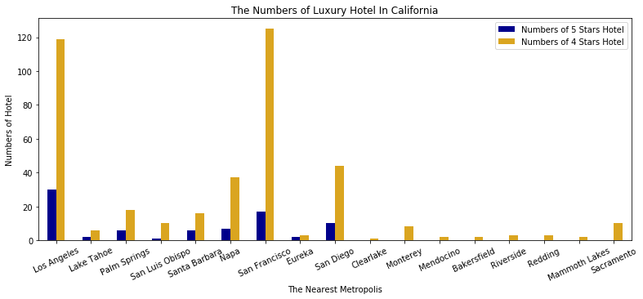
Insight on Hotels

Slide 5
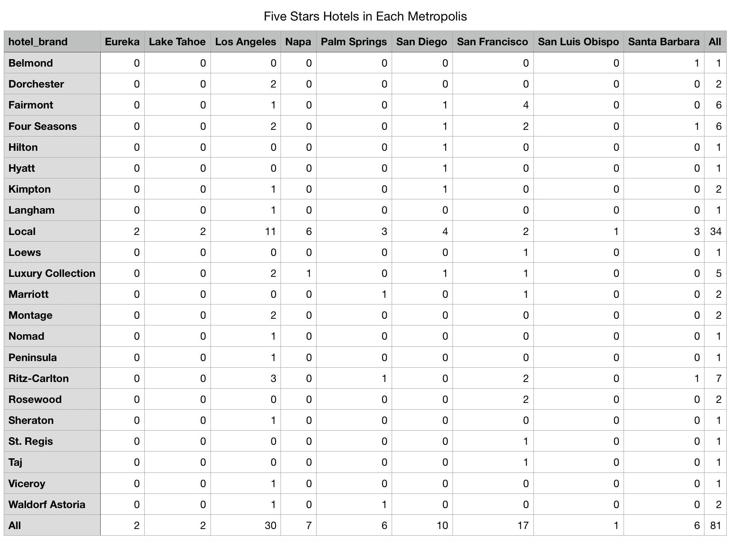
Insight on Hotels

Slide 6
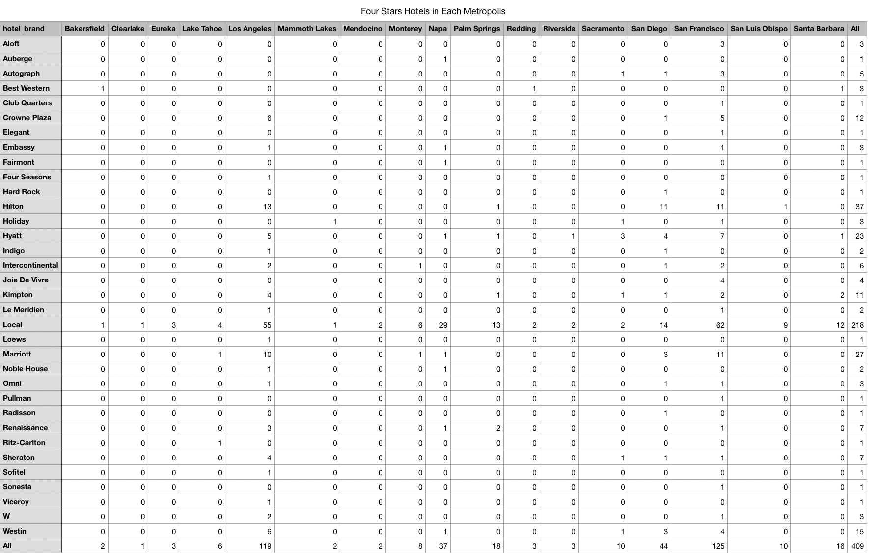
Insight on Hotels

Slide 7
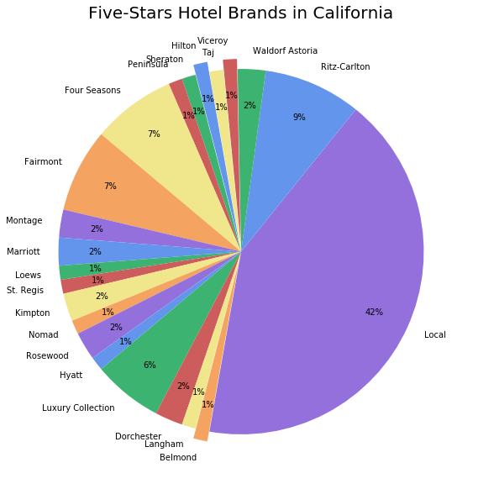
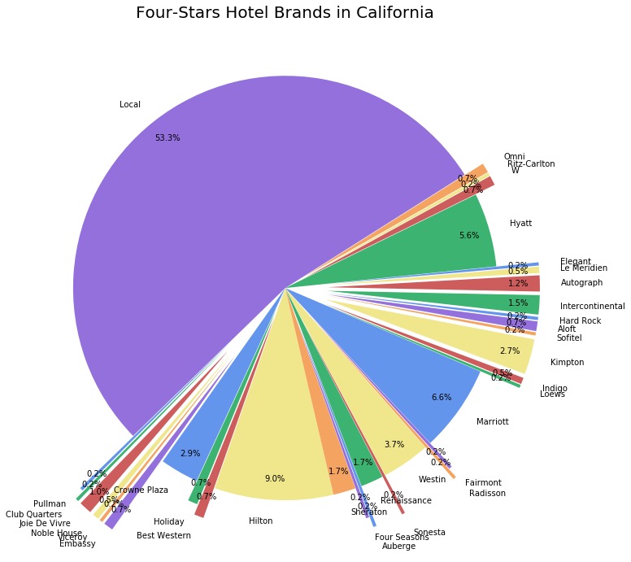
Insight on Hotels

Slide 8
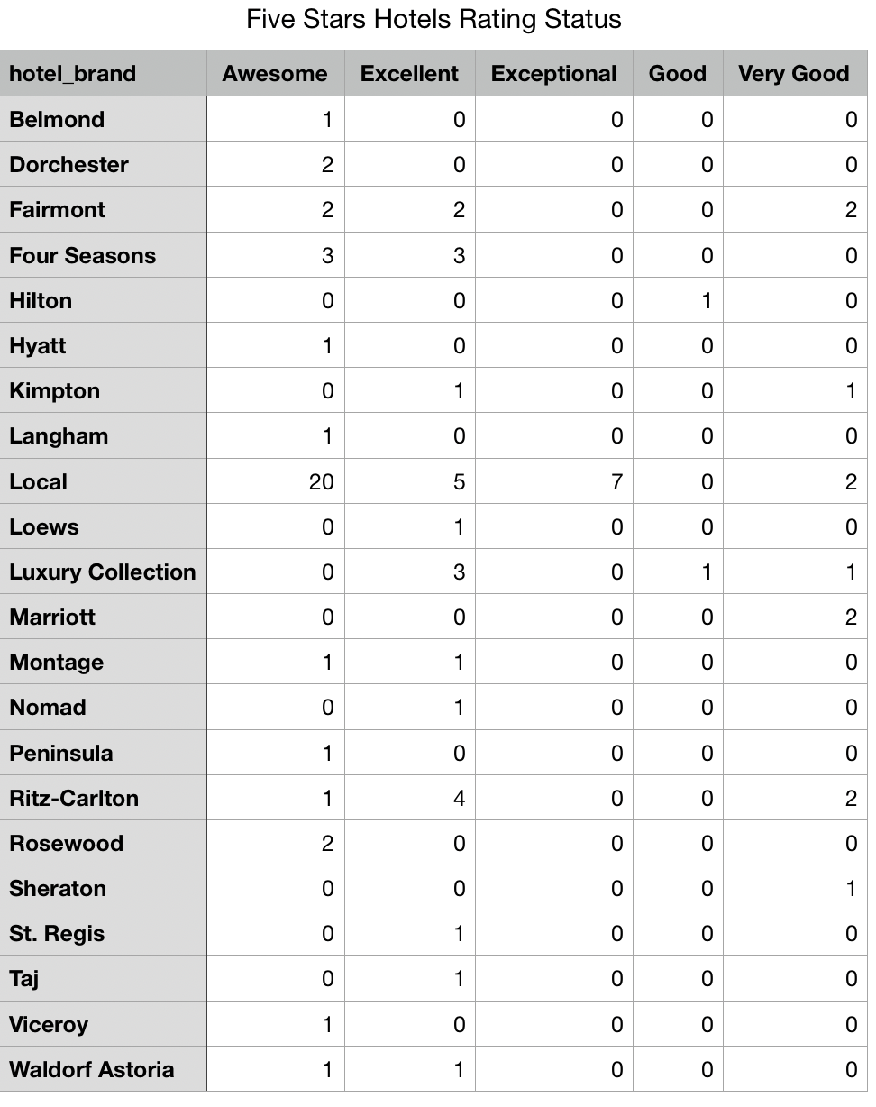
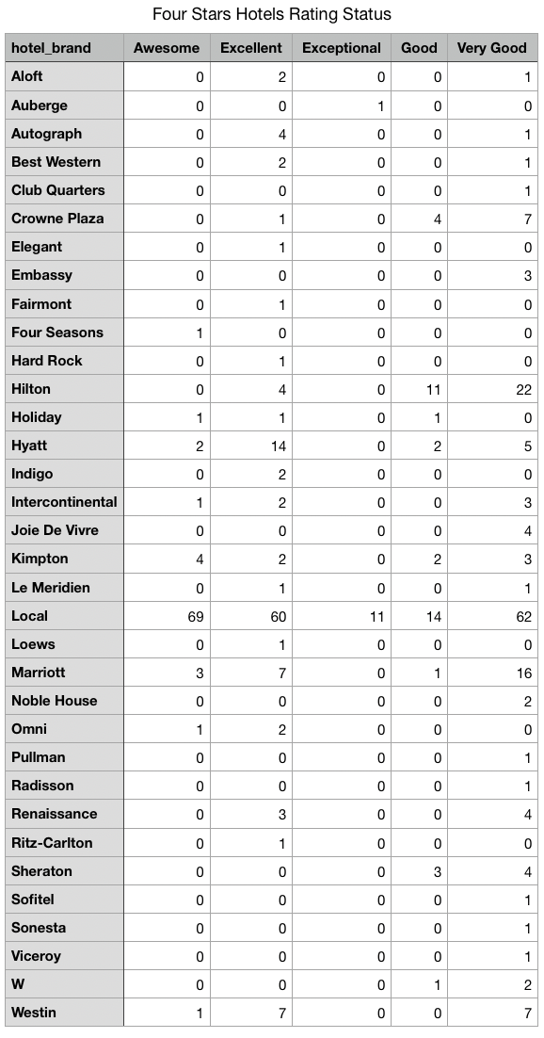
Insight on Hotels

Slide 9
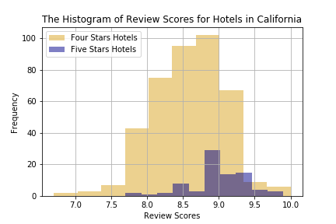
Insight on Hotels

Slide 10
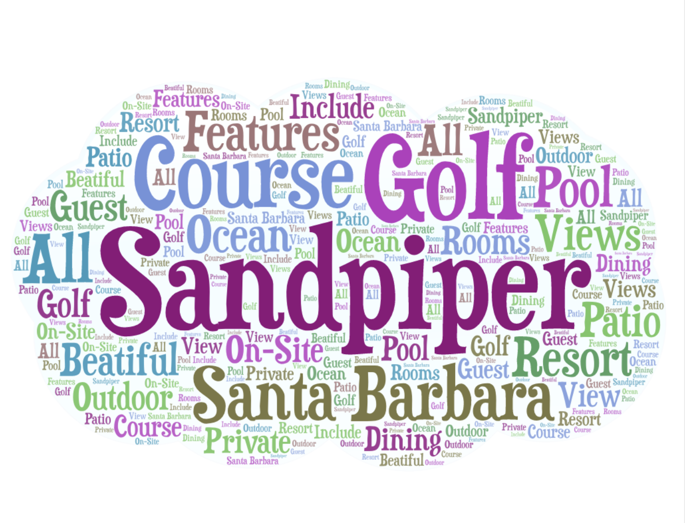
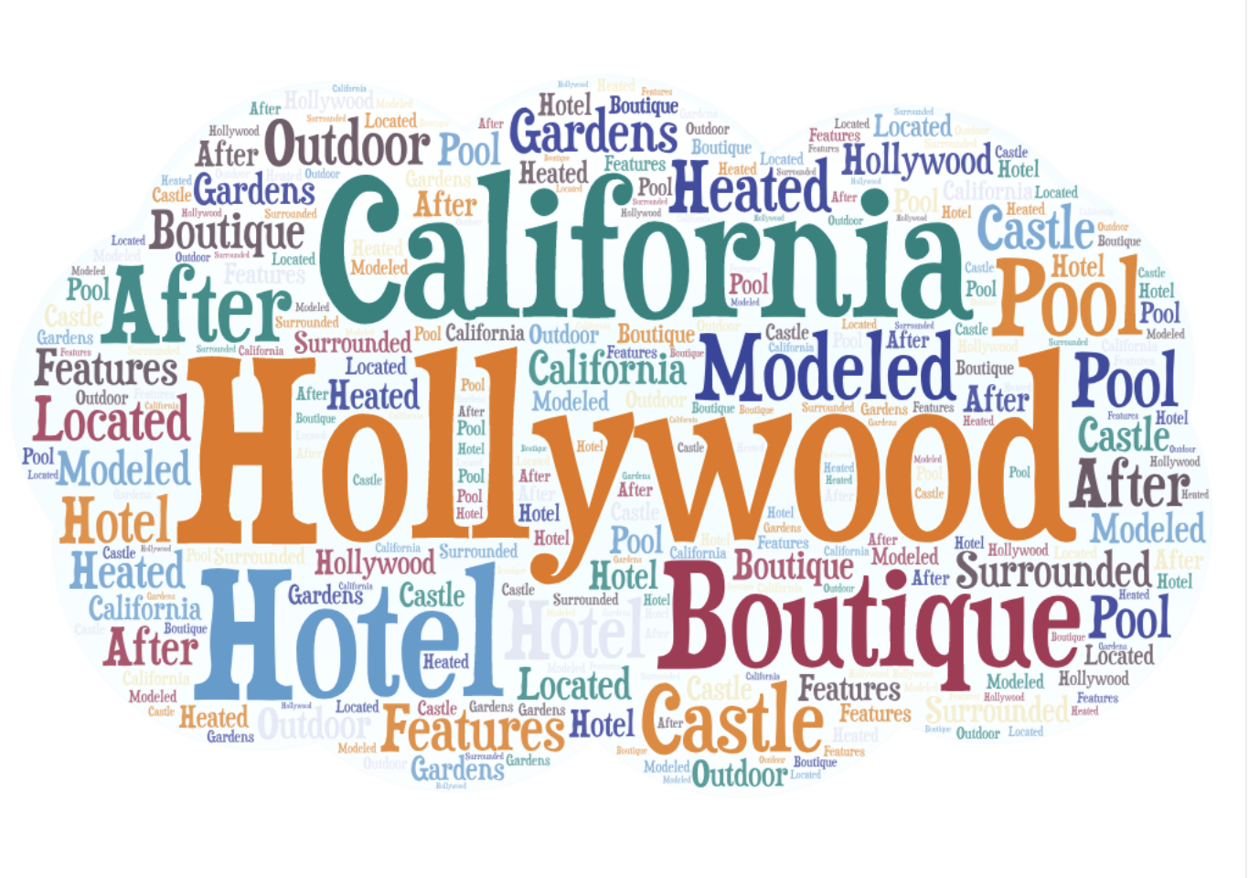
Insight on Hotels
Most frequent words in 5 stars hotels’ descriptions.
Most frequent words in 4 stars hotels’ descriptions.

Slide 11
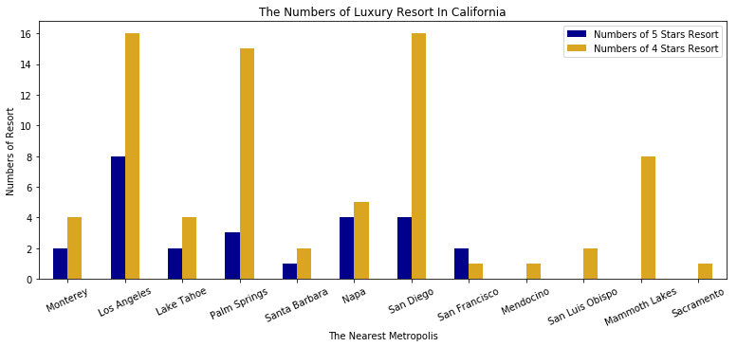
Insight on Resorts

Slide 12
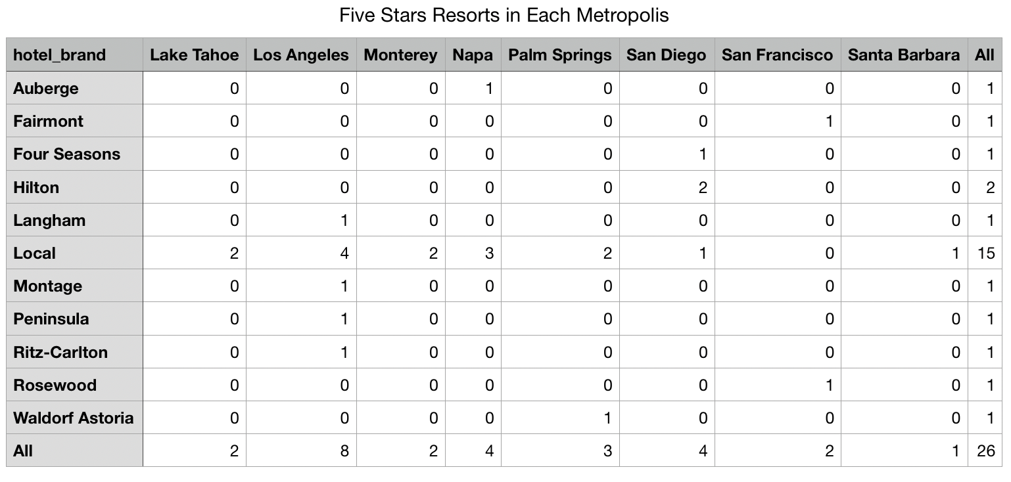
Insight on Resorts

Slide 13
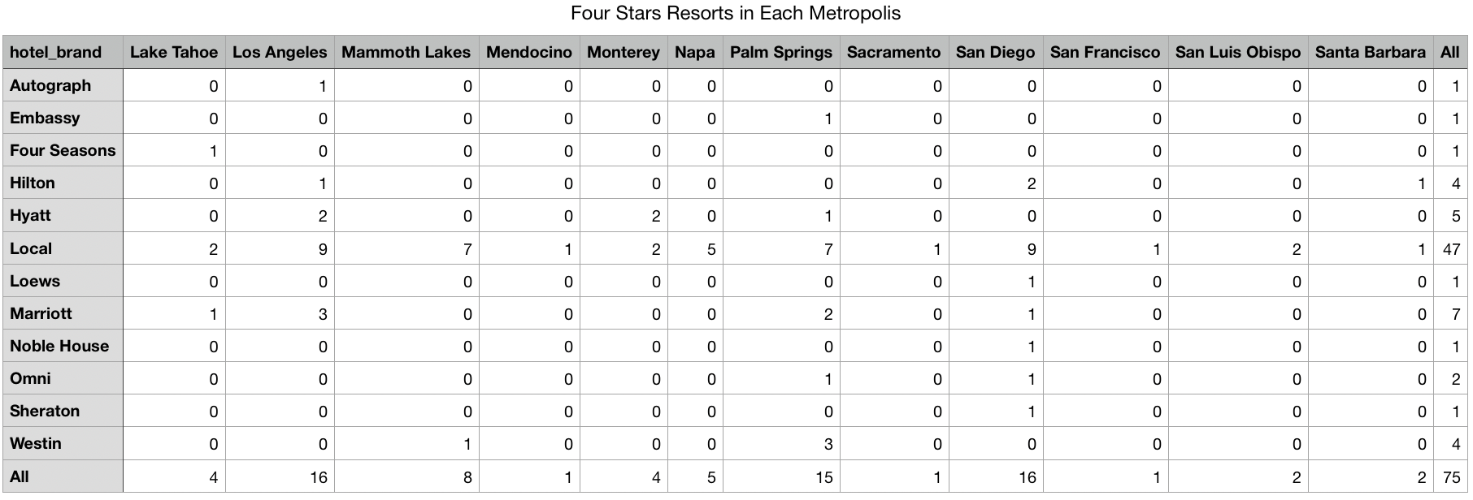
Insight on Resorts

Slide 14
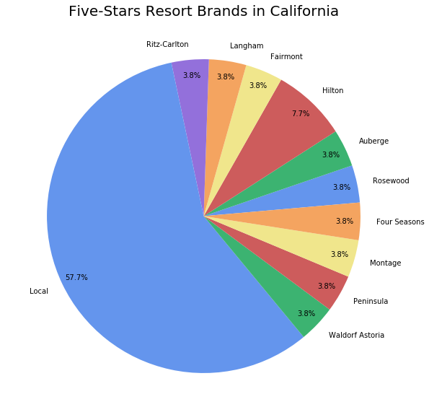
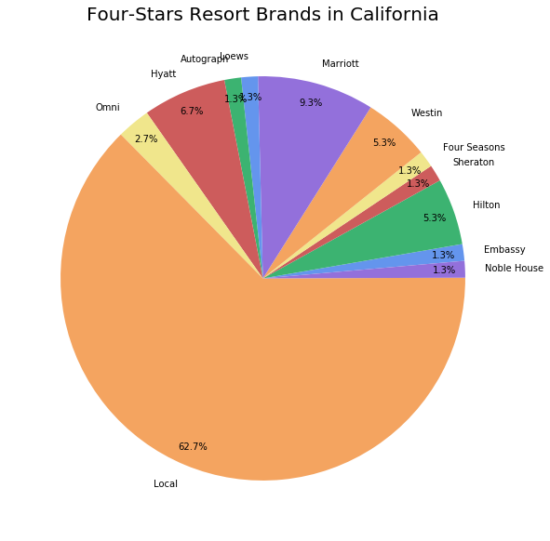
Insight on Resorts

Slide 15
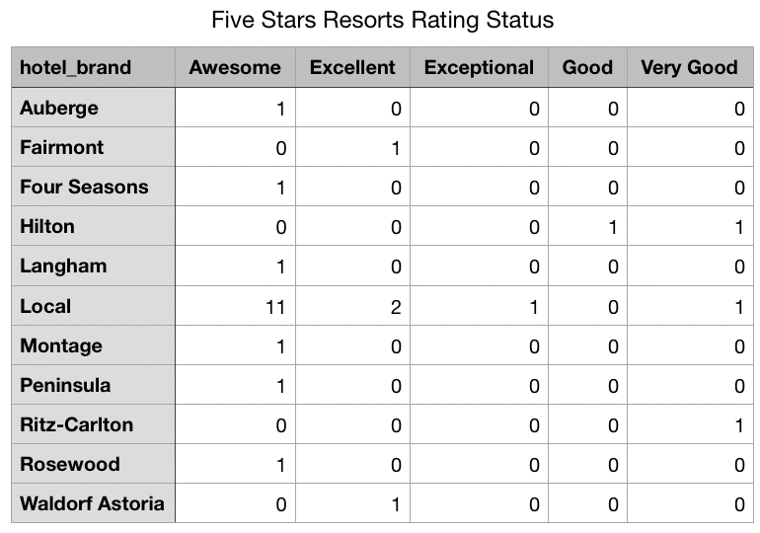
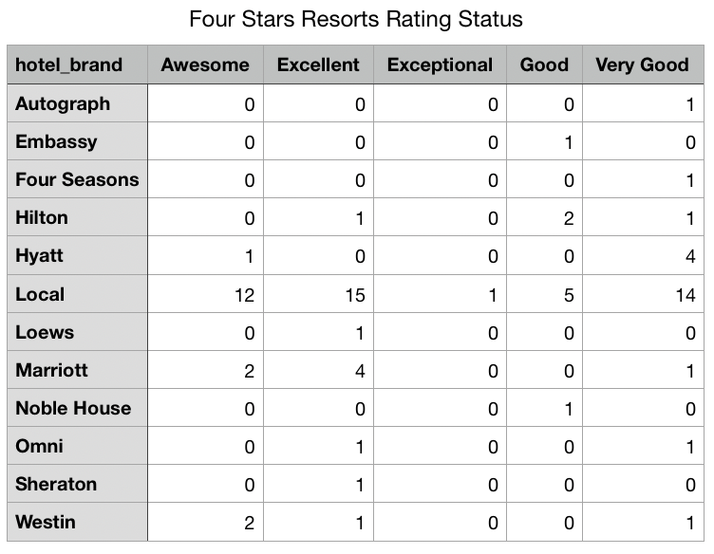
Insight on Resorts

Slide 16
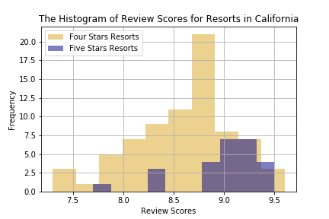
Insight on Resorts

Slide 17
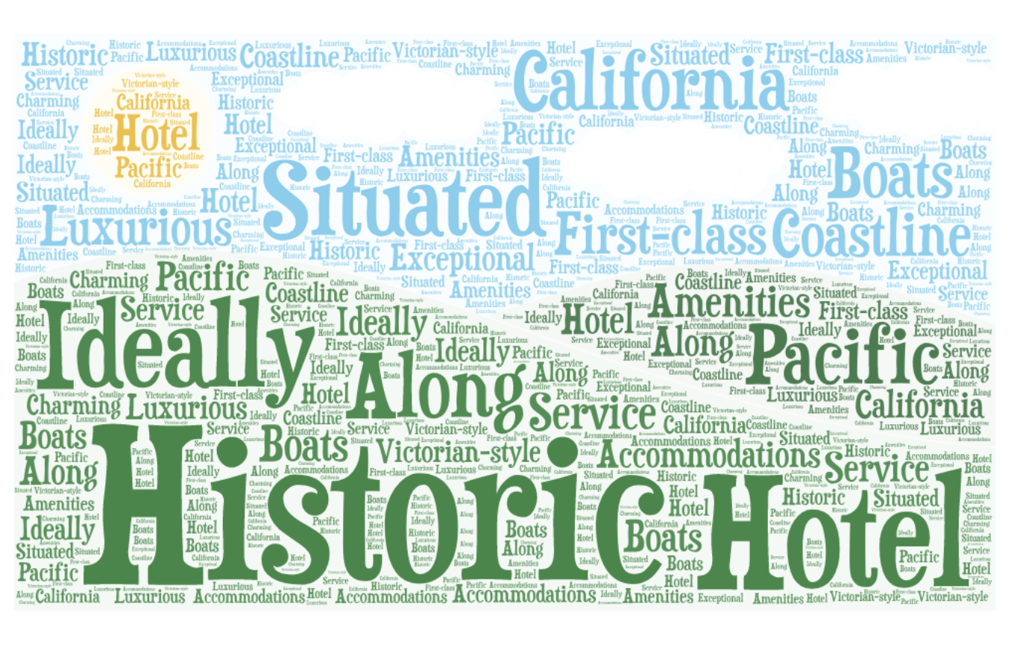
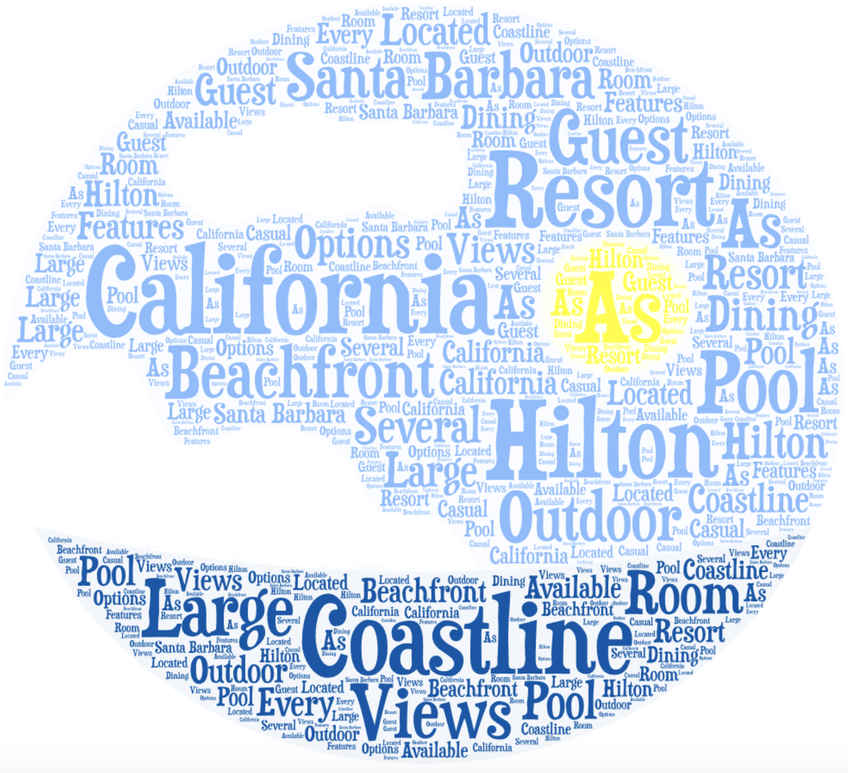
Insight on Resorts
Most frequent words in 5 stars resorts’ descriptions.
Most frequent words in 4 stars resorts’ descriptions.

